Slide 1
Nepal Export: Bovine Paratuberculosis Vaccine
Ashleigh Ahrens
University of Guelph

Slide 2
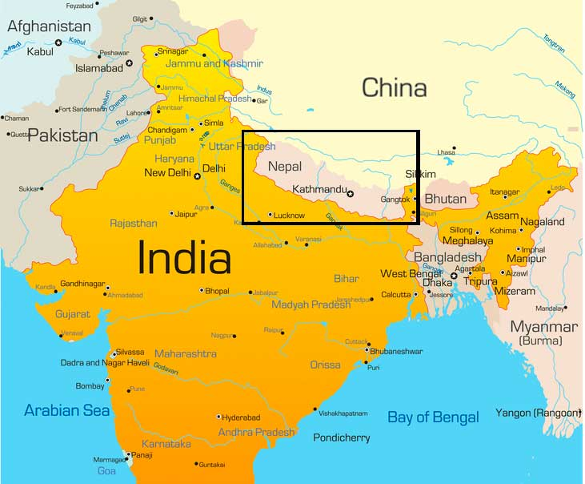
Nepal Geography
landlocked country between China and India
147,181 sq km
8 of highest mountains
http://www.haaretz.com/world-news/1.653894

Slide 3
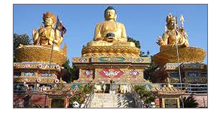
Nepal Population
29,033,914 people
81% Hindu, 9% Buddhist
http://www.buddhist-pilgrimage.com/nepal.html

Slide 4
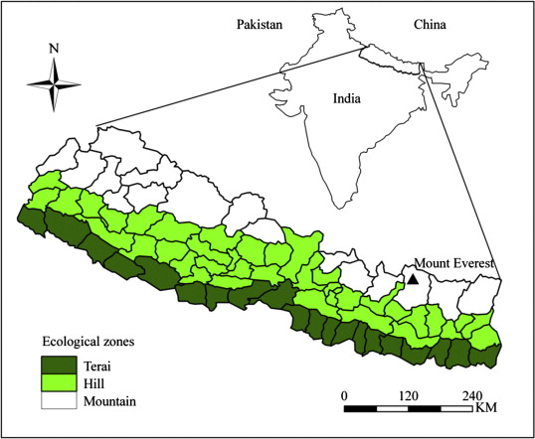
Nepal Agriculture
28% agricultural land
69% of labor force in agriculture
Subsistence agriculture
6.9 million cattle 2003/4
Greatest amount of cattle in the hills
http://www1.american.edu/ted/ICE/terai.html

Slide 5
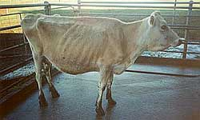
Bovine Paratuberculosis
Weight loss, diarrhea, eventual death
Signs don’t show until 2 years of age
Infected when young by ingesting bacteria
Fecal shedding is major source of transmission
http://agriculture.vic.gov.au/agriculture/pests-diseases-and-weeds/animal-diseases/beef-and-dairy-cows/bovine-johnes-disease/what-is-bovine-johnes-disease

Slide 6
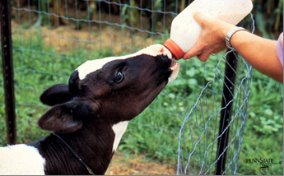
Treatment/Control
Sanitation and management practices
Frequent testing
Cull infected animals
https://www.beefboard.org/eNews.asp?id=13995

Slide 7
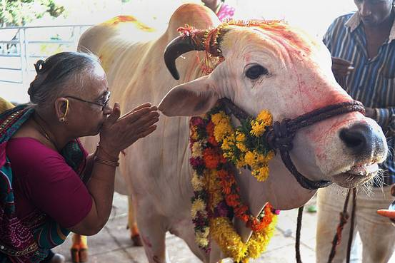
Implications in Agriculture
Decreased milk production
Decreased fertility
Unable to cull cattle in Nepal
http://blogs.wsj.com/indiarealtime/2015/10/13/qa-d-n-jha-author-of-the-myth-of-the-holy-cow/

Slide 8
Hsp70 vaccine
Does not interfere with bovine TB testing
Reduces fecal shedding
Increases life span and therefore productivity

Slide 9
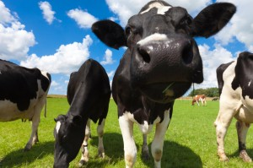
Benefits to Nepal
Increased productivity and longevity
Decreased transmission and infection
http://www.hollyrilinger.com/nutritional-pillar-5-eat-good-meat/

Slide 10
Benefits to Canada
No bovine tuberculosis testing interference
New vaccine for Canada use

Slide 11
StressMarq BiosciencesInc.
Supplies recombinant bovine hsp70 protein
Victoria, BC, Canada
http://www.stressmarq.com/?v=3e8d115eb4b3

Slide 12
Biogenuix
New Delhi, India
Distributor of StressMarq BioSciences products
http://biogenuix.com/

Slide 13
Acknowledgements
Ashleigh Ahrens
University of Guelph in partnership with IDRC CIFSRF and DFAIT
~ 4 min 33 seconds
Faculty Sponsor: Prof. Manish Raizada (raizada@uoguelph.ca)
For further information: A detailed written evaluation of this export idea is posted on saknepal.org

